Slide 1

Detecting Fake News Using Machine Learning Algorithm
By-
ARITRA GHOSH- 19MCA0093
NILESH KUMAR THAKUR- 19MCA0117
PANKAJ MALLICK- 19MCA0223

Slide 2
Contents
Problem Statement
Abstract
Literature Survey
Proposed work plan
Module description
Working
Conclusion

Slide 3
PROBLEM STATEMENT
Classification of the news so that the real news and fake news can be detected easily by readers.

Slide 4
ABSTRACT
Fake news have been a serious issue now a days as the advancement of social media gives a platform to spread this fake news in a greater extent. It is easy to manipulate people in believing fake news on social media platform by using some invoking keywords. Fake news could be used by an individual for numerous commercial and political benefit. We know that social media is accessible to a large population, so it becomes easy to escalate such news to a large mass in minimum time. There has been lot of researches who identified this problem as a classification problem with binary values. Various machine learning and deep learning algorithms have been proposed to build a model that can classify news with certain accuracy. We would be using Natural Language Processing (NLP) to extract out the keywords that will be determining whether the news is fake or not. After extracting out those keywords, we would apply Support Vector Machine (SVM) to classify the dataset whether the news is real or fake

Slide 5
LITERATURE SURVEY
We have reviewed 8 papers. Most of papers have done classification among real and fake news on different datasets.

Slide 6
Proposed WORK plan
Creating a model for training using a dataset downloaded from Kaggle. The training dataset contains 4009 records which can be used for accurate prediction.
As the amount of data is high therefore chances are that the data will not be linearly separable by a hyperplane. However, to classify non linear dataset, we will project these datasets into higher dimension in which it will be linearly separable.
We would be comparing among different algorithms to check which one gives better accuracy.

Slide 7
Module description
DATA COLLECTION
Our data has been taken from Kaggle .

Slide 8
Module description
IDENTIFY FEATURES AND DIMENSION REDUCTION
For this classification method, we haven’t taken the URL feature as it have no use for classification.
After that, we must check the relation among the features and according to that, reduction of dimension.

Slide 9
Module description
SPLITTING OF TEST AND TRAINING SET
We need to split the dataset into testing and training data. We will use 80% of the whole dataset for training purpose and 20% of the whole data for testing purpose.

Slide 10
Module description
SELECTION OF MODEL AND TRAIN DATA FOR CLASSIFICATION
For this classification purpose, we have selected three algorithms such as SVM, KNN and Random Forest Classification. We have tried to get the highest accuracy point among these three algorithms.

Slide 11
Module description
CLASSIFYING THE DATASET WITH THE ALGORITHMS
Now we use the three algorithms on the given training dataset for checking the accuracy level.

Slide 12
Working

Slide 13
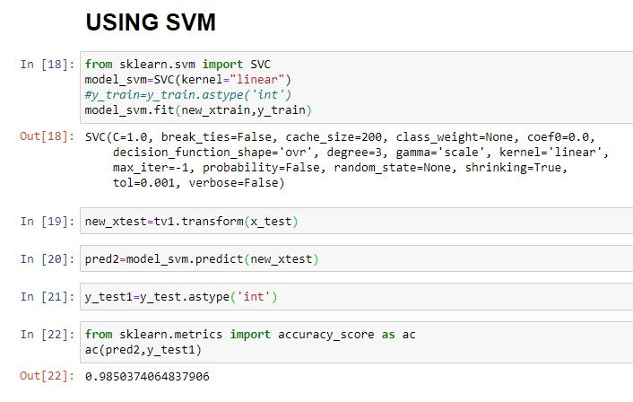
Accuracy using SVM
Using Support Vector Machine we are getting an accuracy of 98.5%.

Slide 14
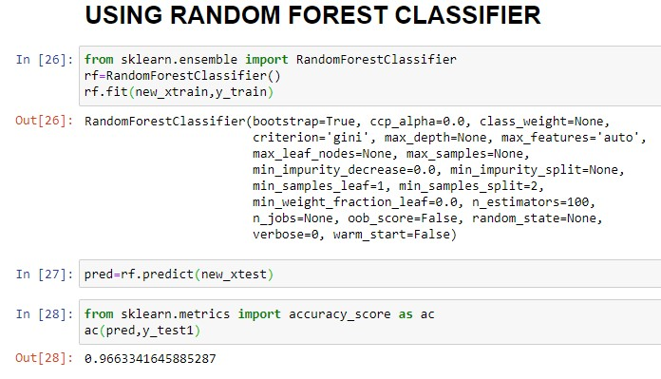
Accuracy using Random forest classifier
Using Random Forest Classifier we are getting an accuracy of 96.6%.

Slide 15
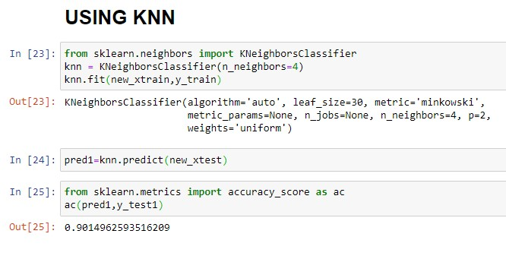
Accuracy using KNN
Using K Nearest Neighbors we are getting an accuracy of 90.1%.

Slide 16
conclusion
The authenticity of the news posted on the Internet is crucial to identify. The paper addresses the components for False news identification. A feeling that not everyone spreads the false news through web-based networking sites. The proposed KNN, SVM and Random Forest system is currently being evaluated. In the future, hybrid approaches for the same purpose will provide better results.

Slide 17
THE END

